Slide 1
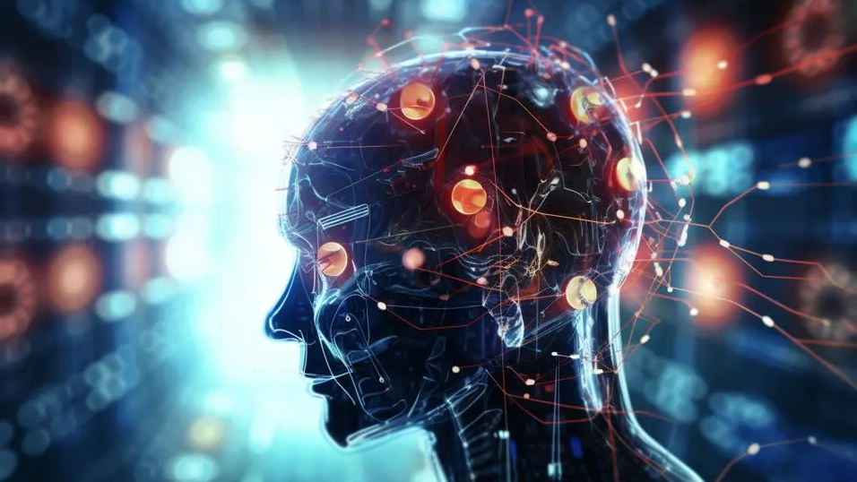


Neuroscience: applications
Ruth Slaughter, Rattana Manyseng, Robert Cocker

Slide 2
Objective
Define what neuroscience is, provide an example where data science methodologies can be applied, and describe what are its real-world applications.

Slide 3

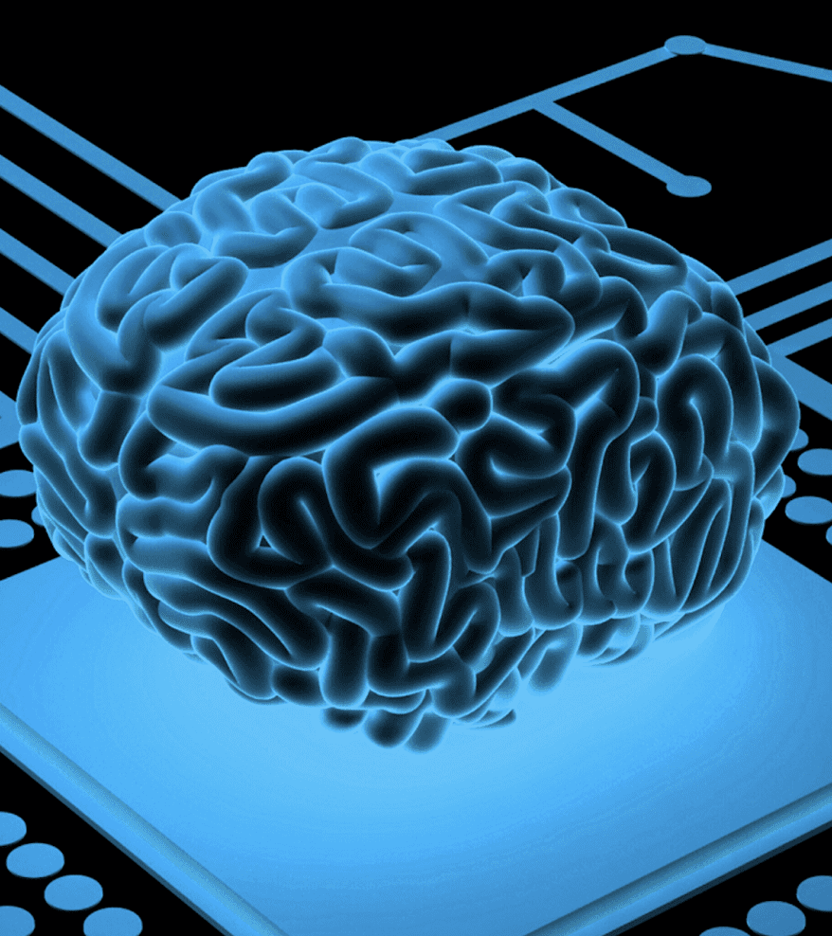

agenda
What is Neuroscience
Insights
Alzheimer’s EDA
Applications
References
Q&A​

Slide 4

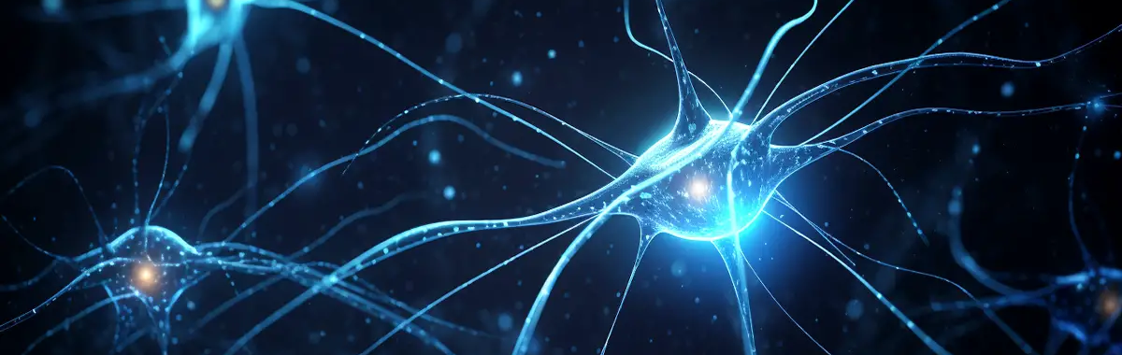
neuroscience
Any or all of the sciences, such as neurochemistry and experimental psychology, which deal with the structure or function of the nervous system and brain.

Slide 5
Insights
Lifetime risk for Alzheimer's at age 45 is 1 in 5 for women and 1 in 10 for men
2% of the US population have Alzheimer's disease (roughly 7 million of 332 million Americans).
More than 3 million US cases per year
1 in 3 seniors dies with Alzheimer's or another dementia. It kills more than breast cancer and prostate cancer combined.

Slide 6
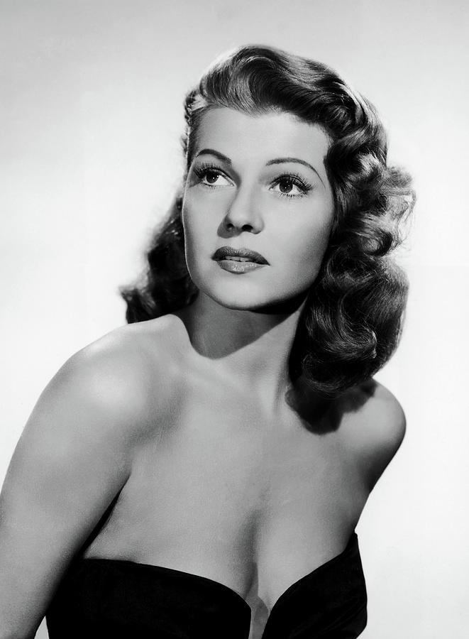
Alzheimer’s
Exploratory Data Analysis
Rita Hayworth 1918-1987

Slide 7
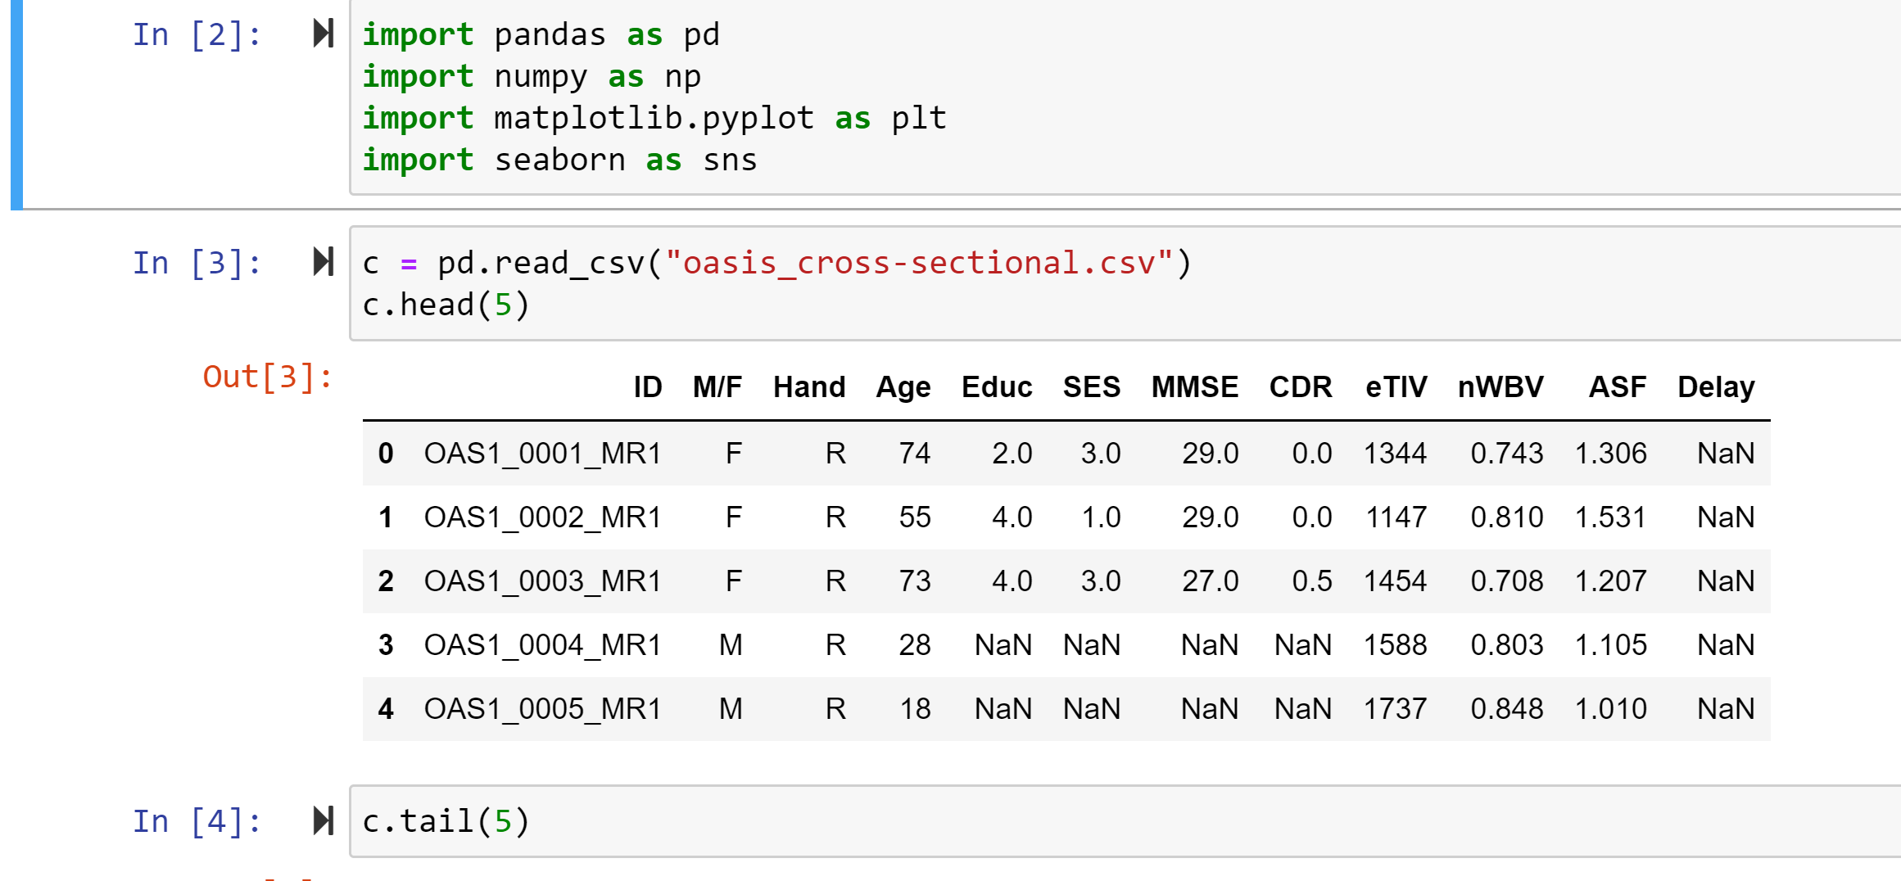
alzheimer's exploratory data analysis

Slide 8
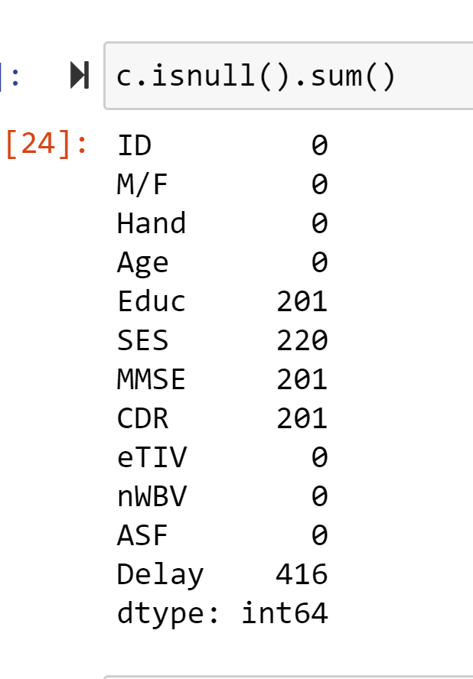
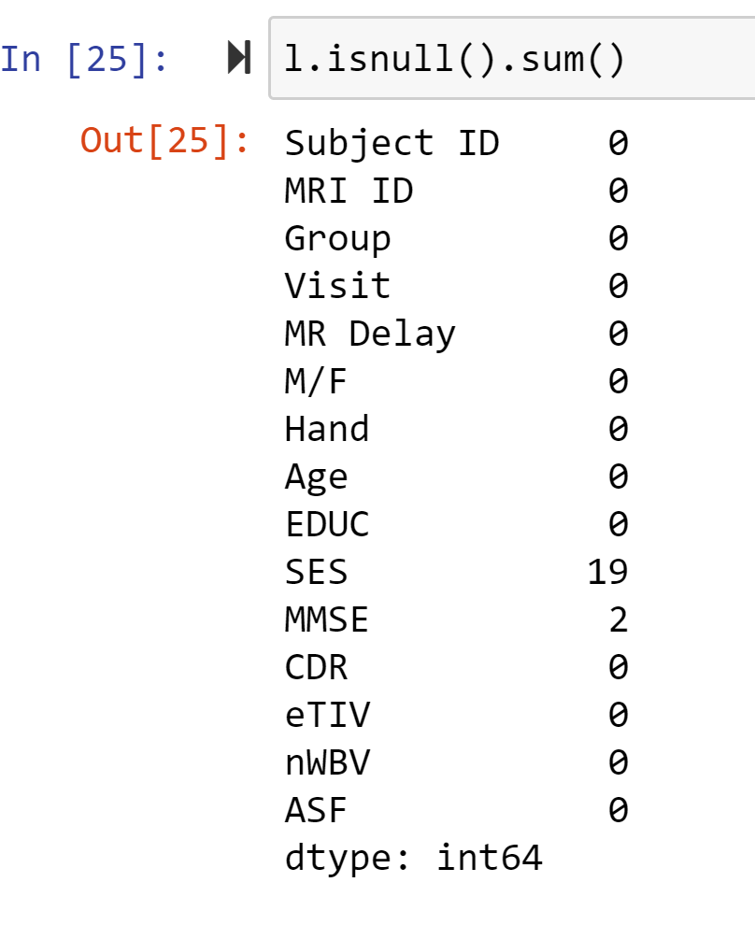
EDA: Check for null values
Cross-sectional dataset (18-96)
Longitudinal Dataset (60-96)

Slide 9
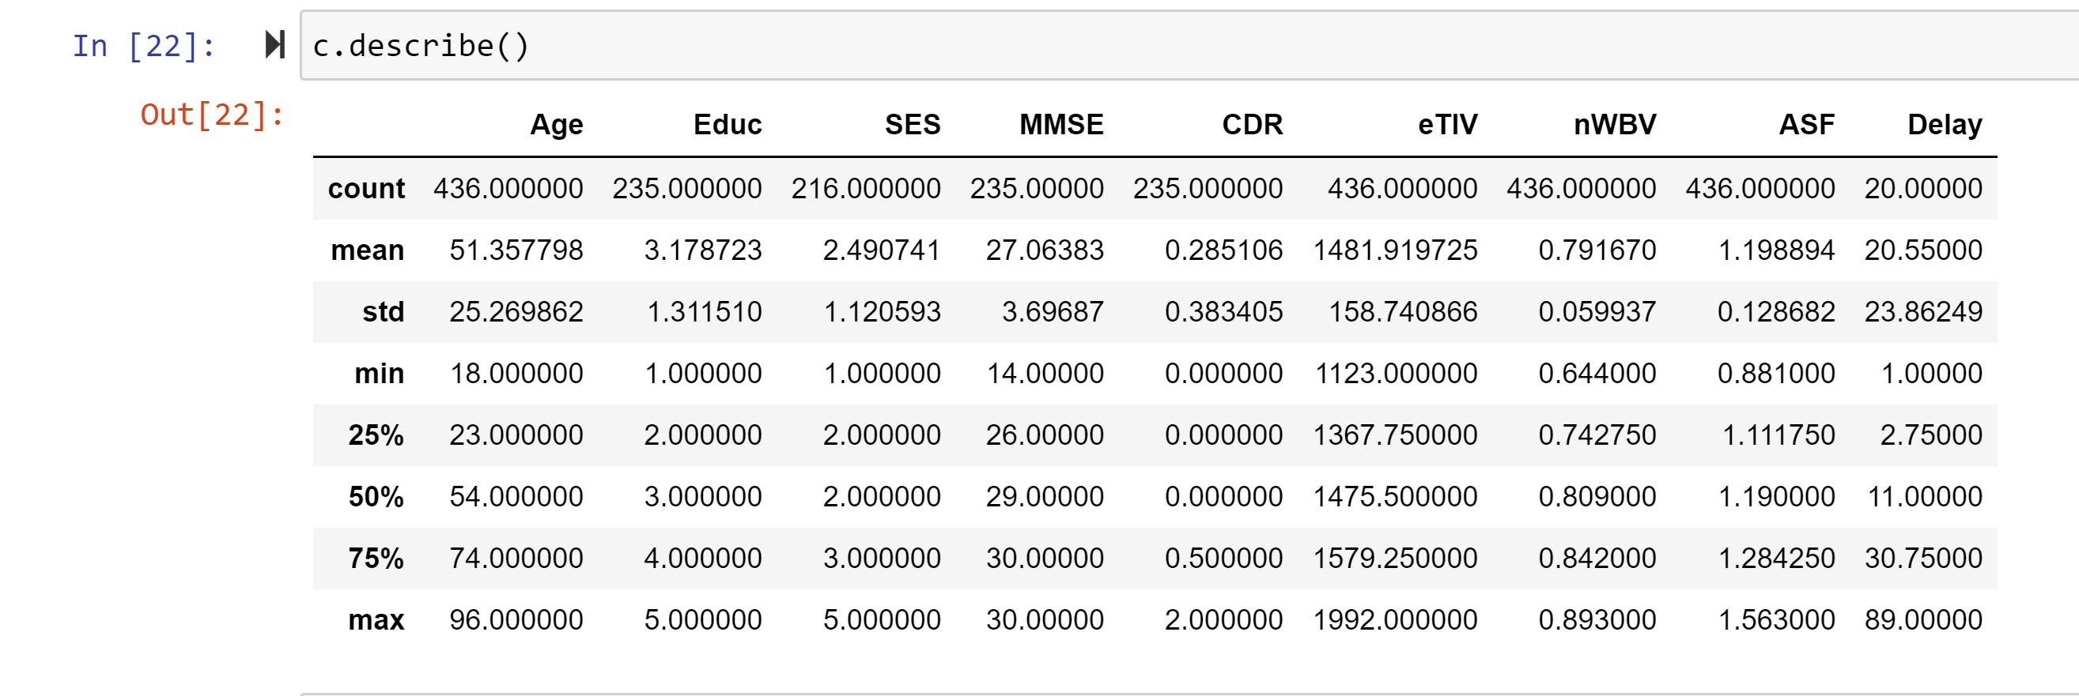
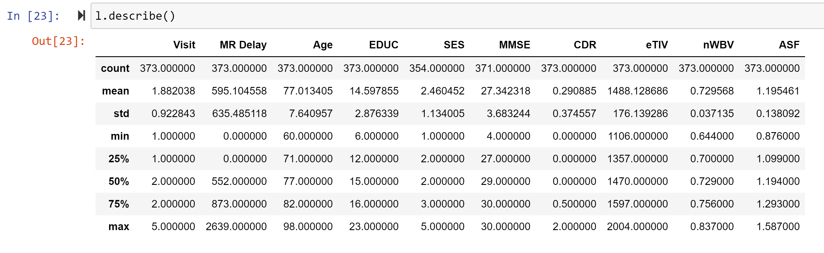
Alzheimer's Exploratory Data Analysis
Average age in cross-sectional dataset 51 with normal cognitive functioning. Average age longitudinal dataset 77 with normal cognitive functioning

Slide 10
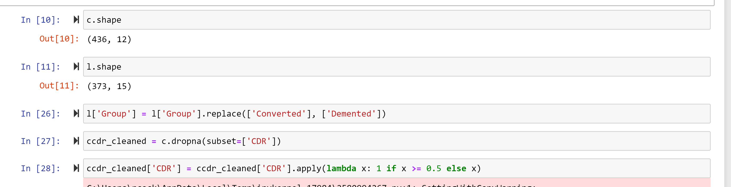
Alzheimer's Exploratory Data Analysis
Analyzing shape of datasets. Dropping null CDR values and CDR conversion of values into 2 numeric value groups Demented vs Nondemented

Slide 11
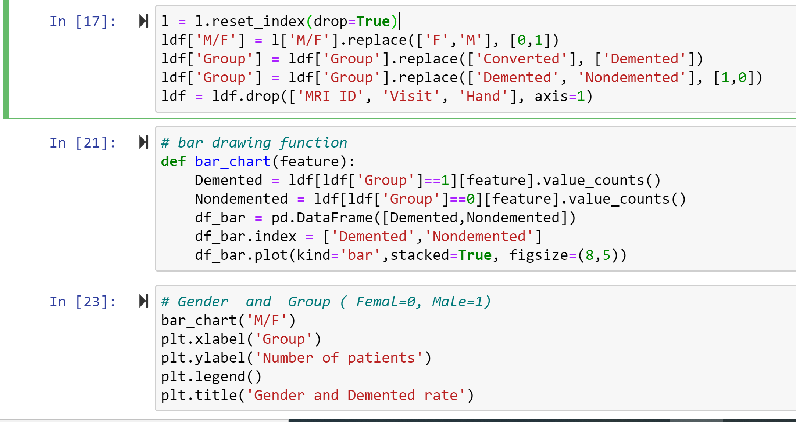
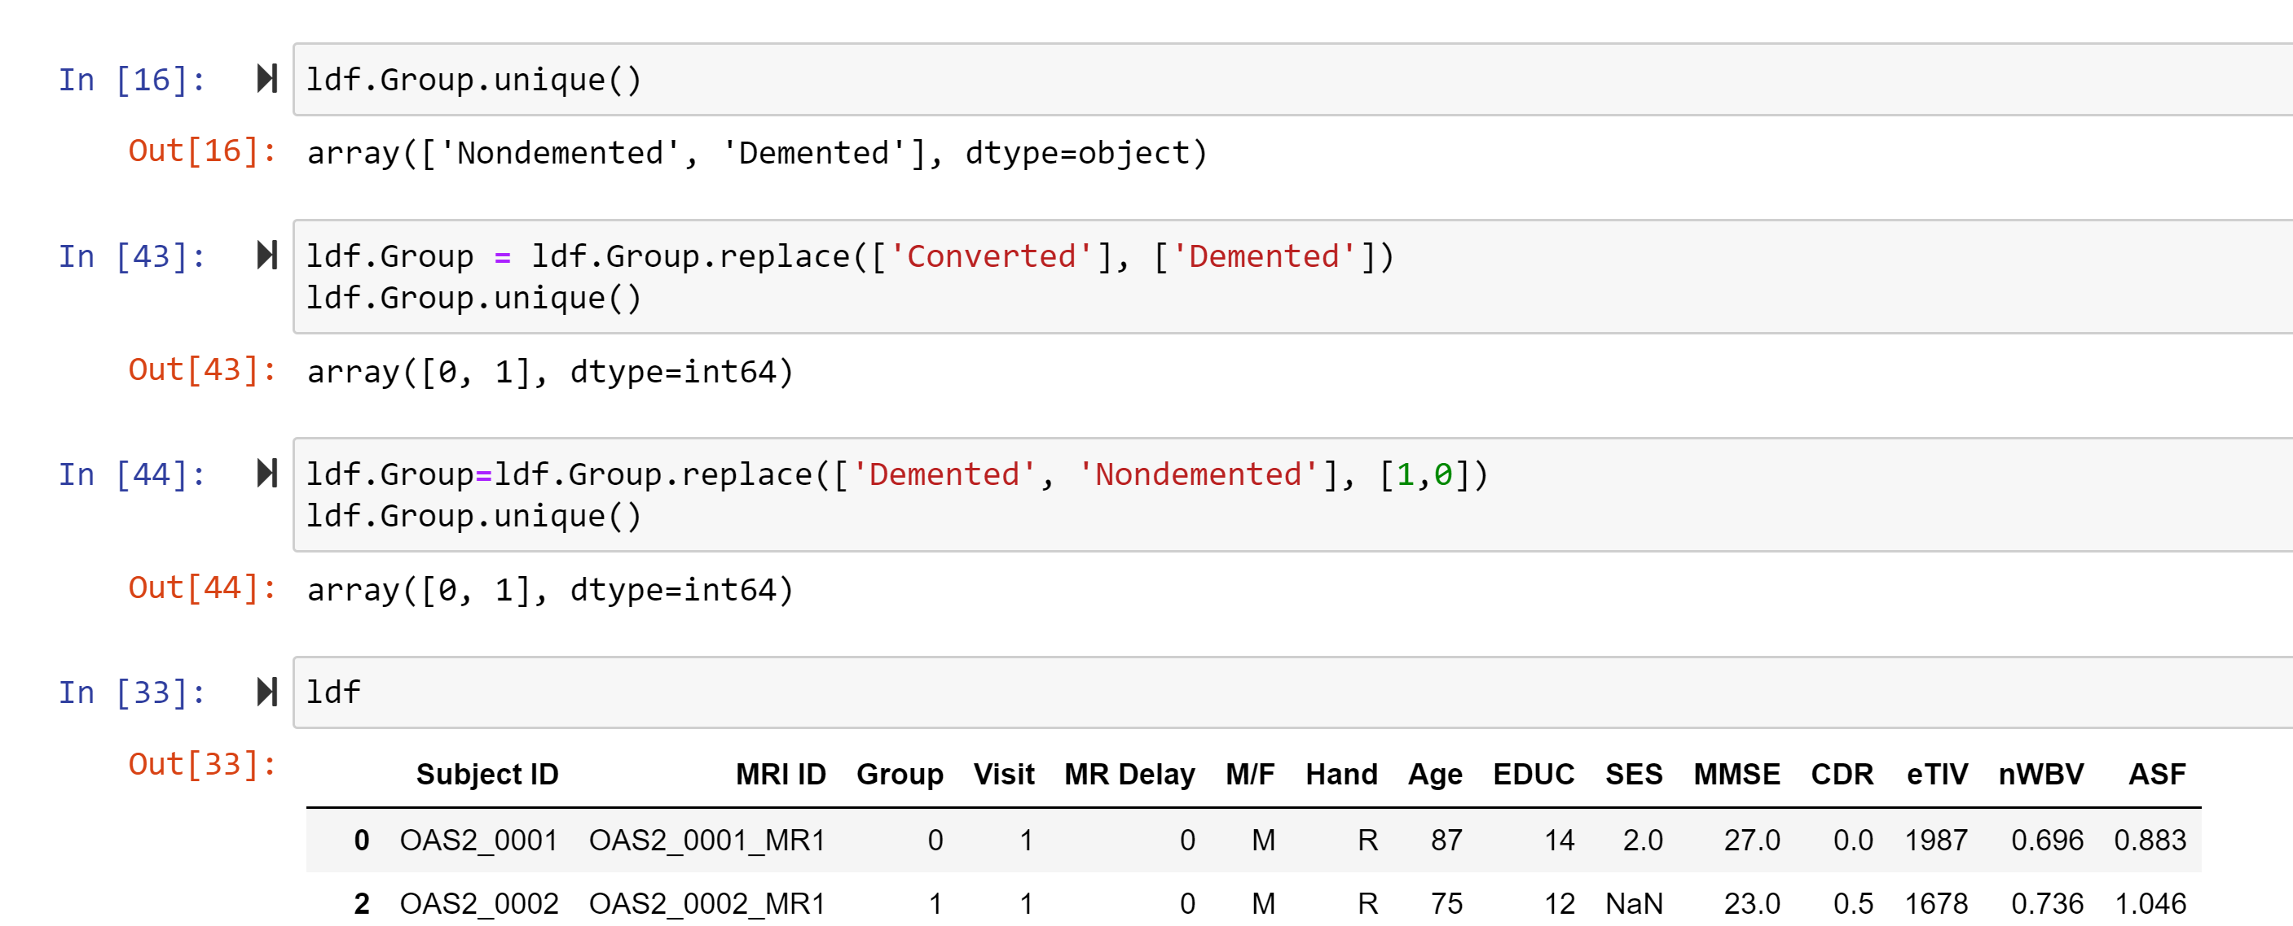
Alzheimer's Exploratory Data Analysis
EDA involved data cleaning, preprocessing, and general analysis to gain insight into the data.

Slide 12
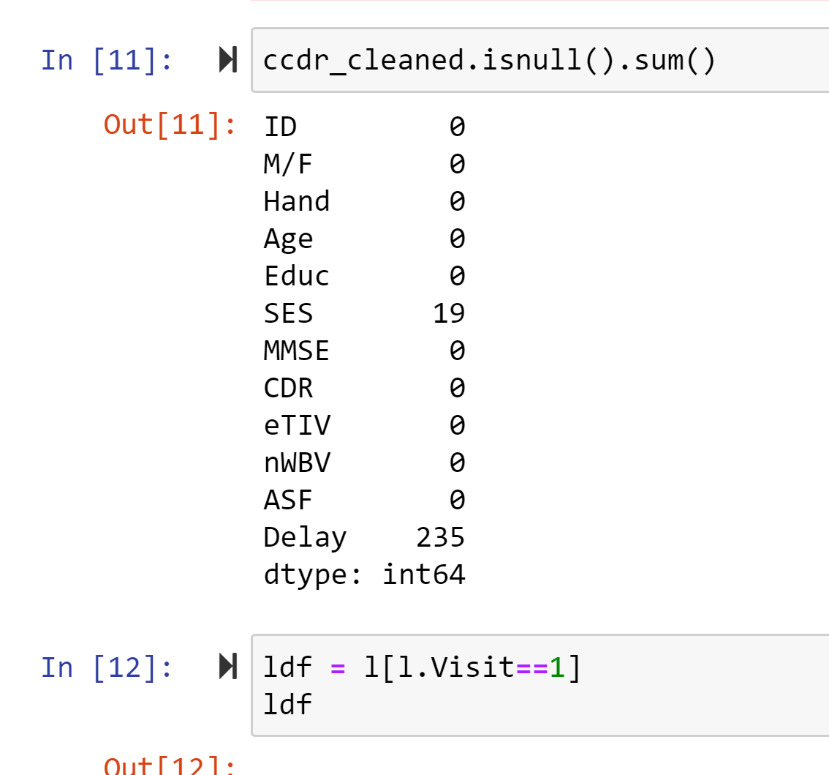
Alzheimer's Exploratory data analysis

Slide 13
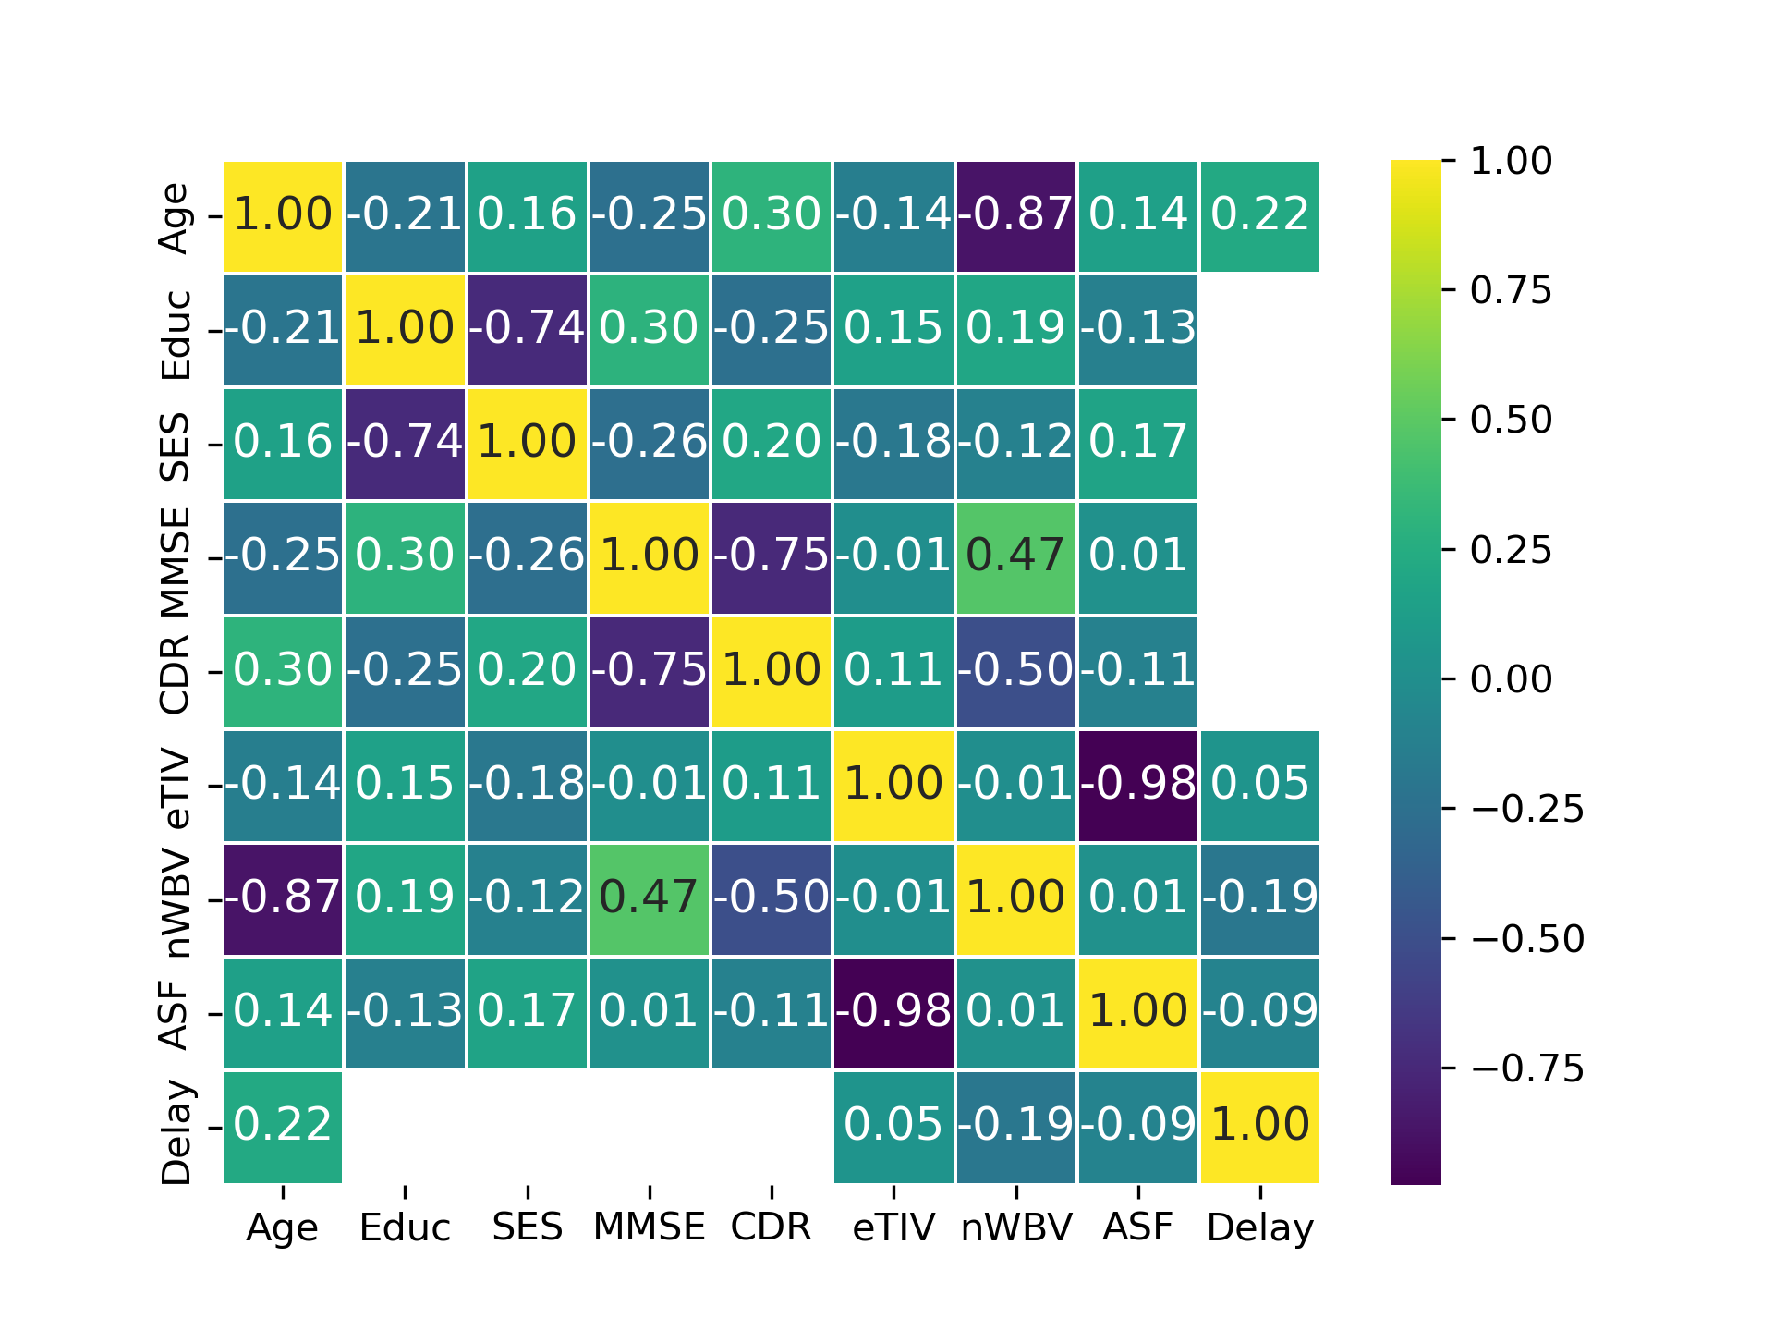
Correlations
Heatmap for correlational data analysis. Main correlation that stood out is MMSE and CDR strong negative correlation. Also possibly related to deterioration due to aging (Age).

Slide 14
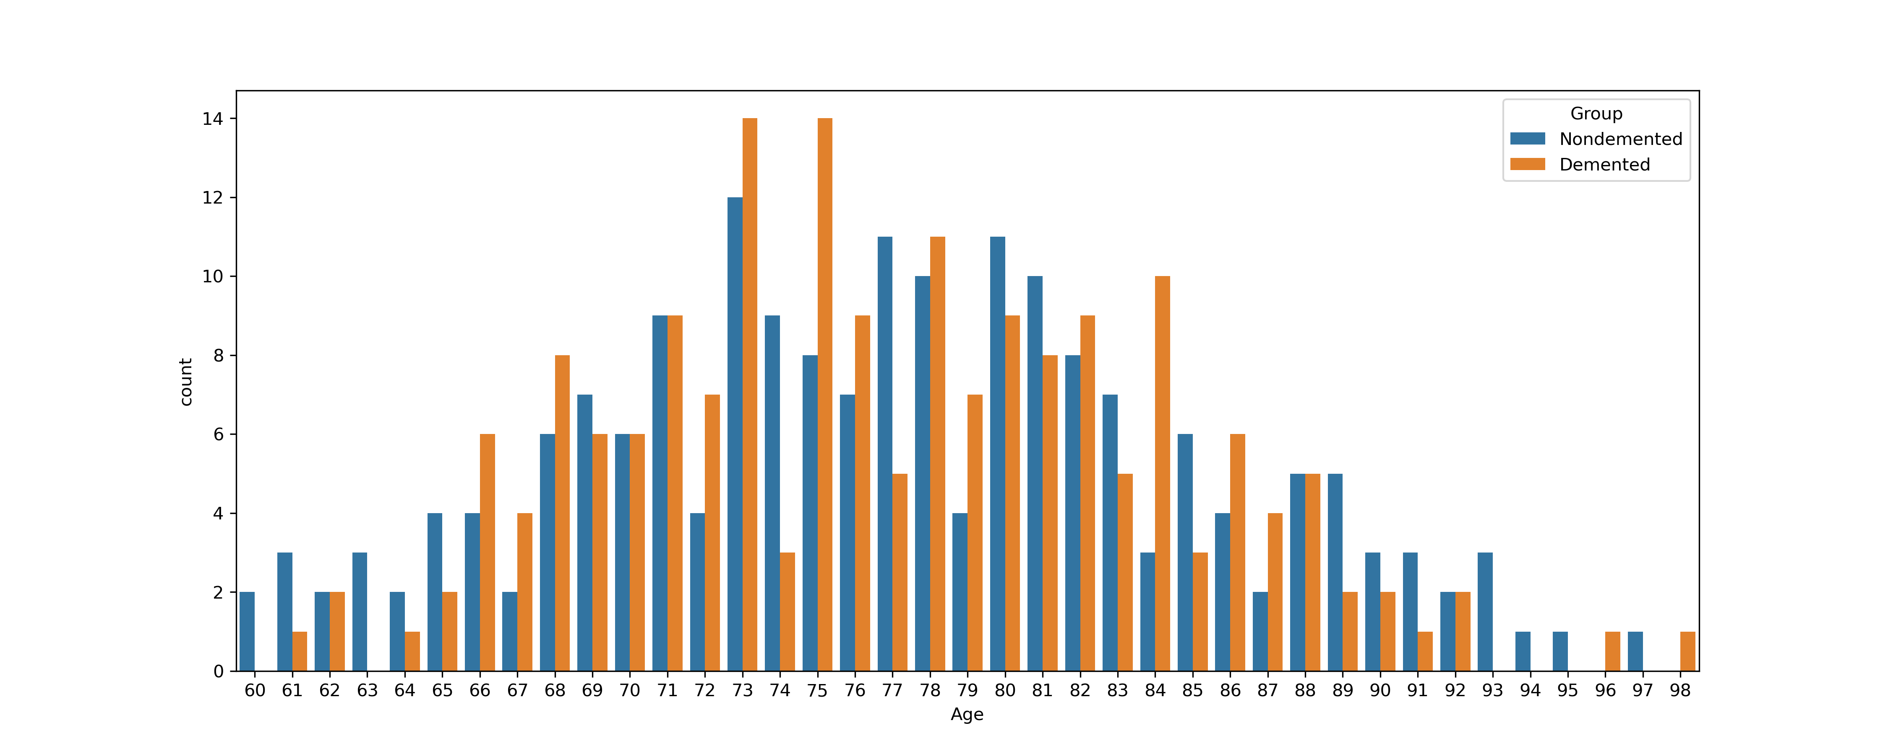
Alzheimer’s by age
Signs of Alzheimer’s begin at about 60’s and into old age

Slide 15
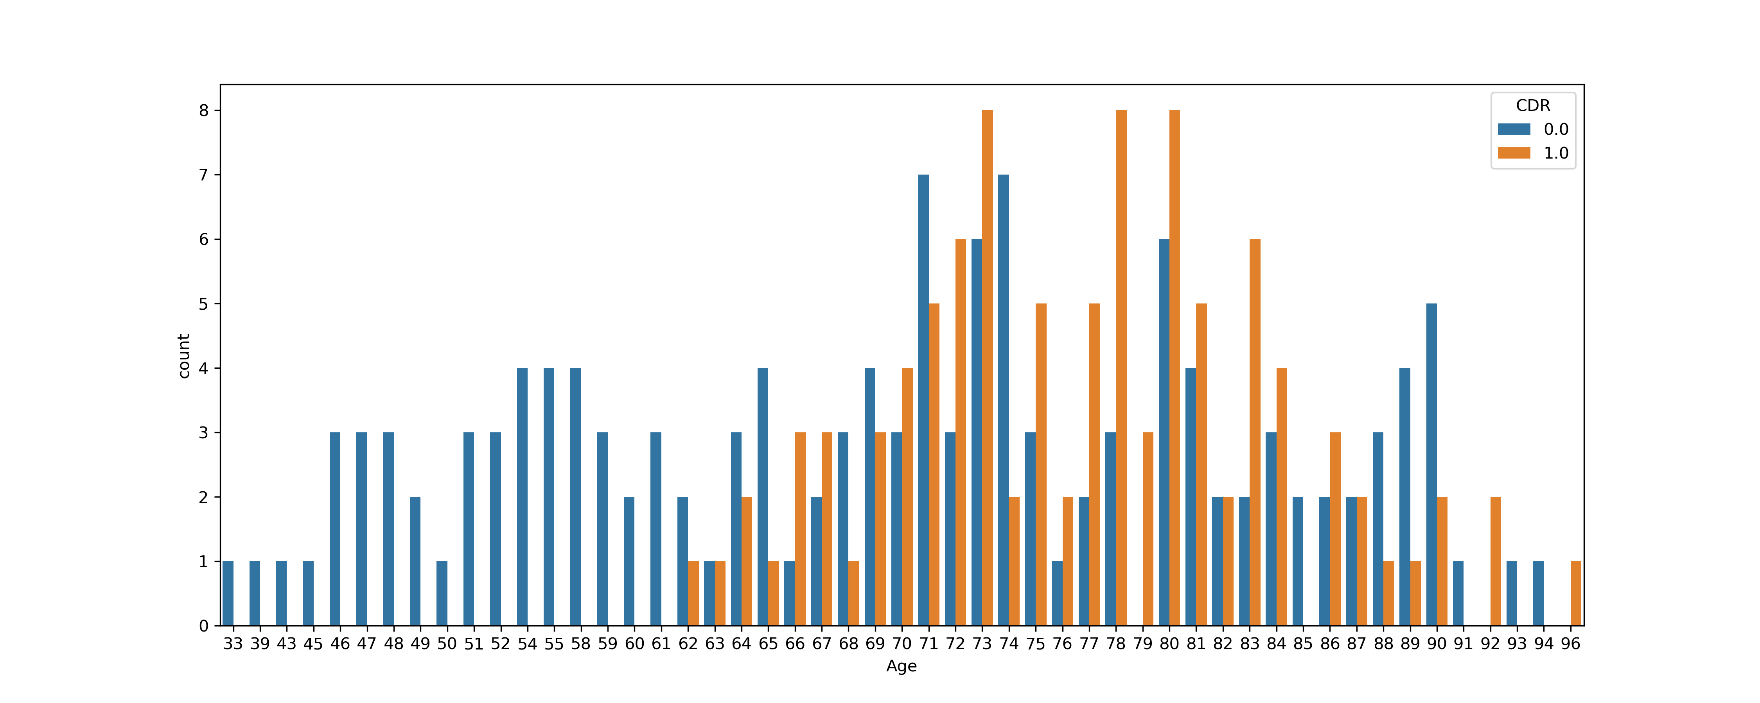
Alzheimer's by age

Slide 16
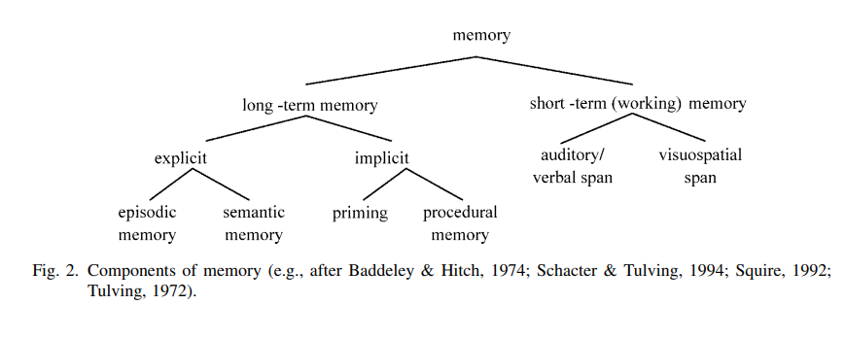
Studies using clinical (i.e., episodic) memory tests are compared with studies using various experimental memory paradigms (semantic memory, implicit memory, working memory).

Slide 17
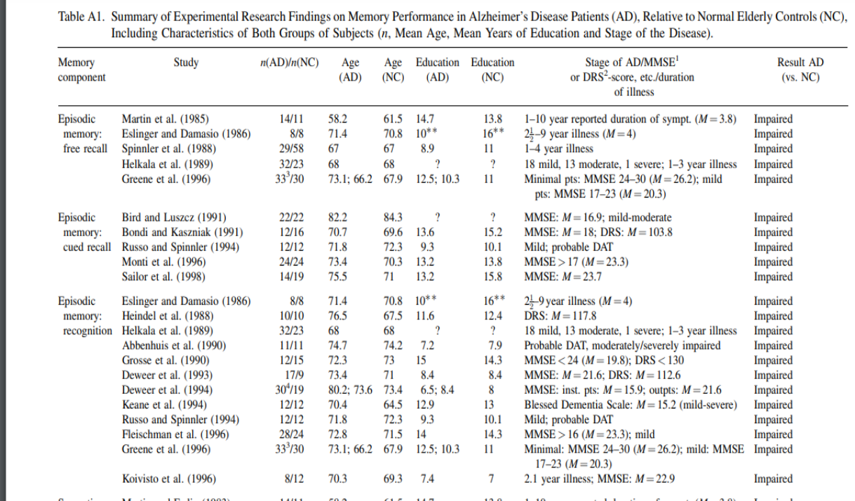
Studies based on stats:

Slide 18
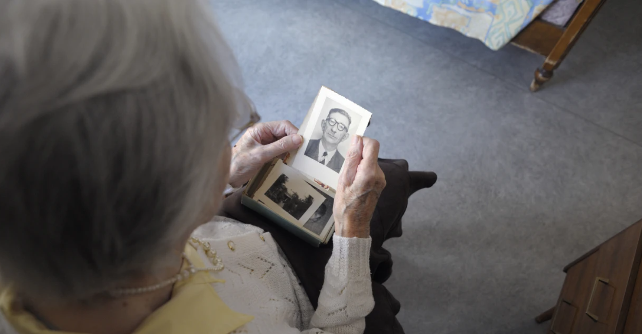
Memory Recall: Test Experiment
Free Memory Recall - participants study a list of items on each trial, and then are prompted to recall the items in any order
Cued Recall - retrieving information from long-term memory using aids or cues
Recognition - familiarize or have access to with certain memories
Category Fluency - familiarize with certain lists or items that fall under a category

Slide 19
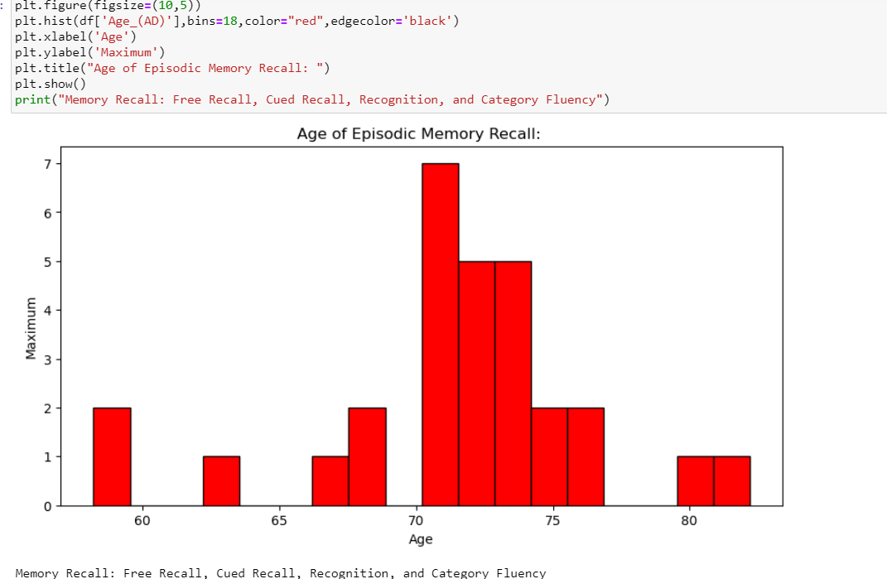

Slide 20
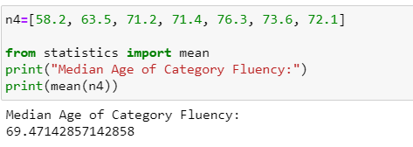
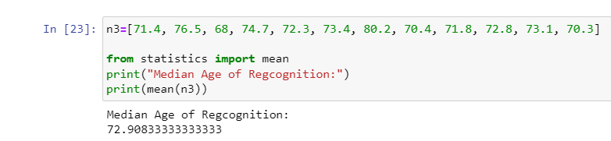
Subcategories of Different Studies: Median Age
20
20XX

Slide 21
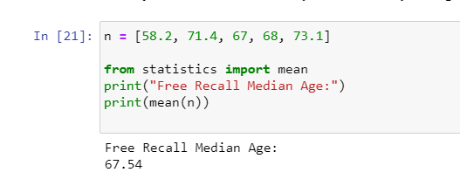
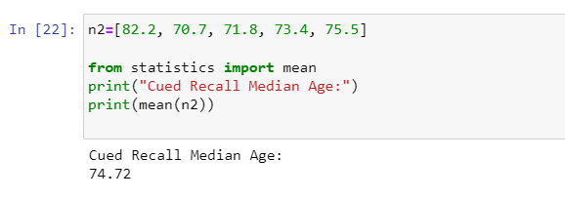
Subcategories of Different Studies: Median Age

Slide 22
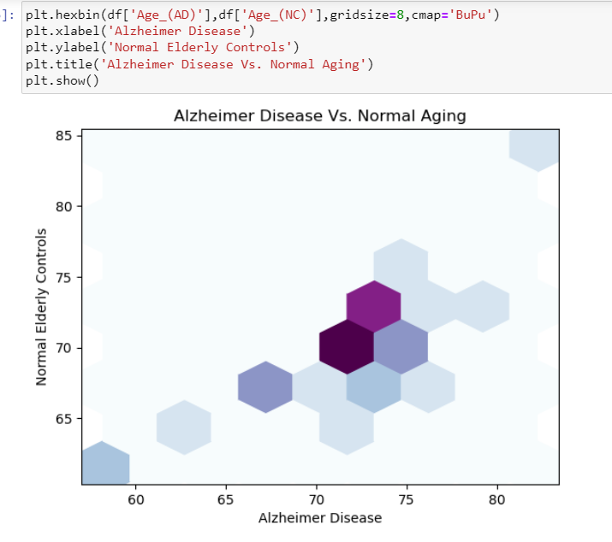

Slide 23
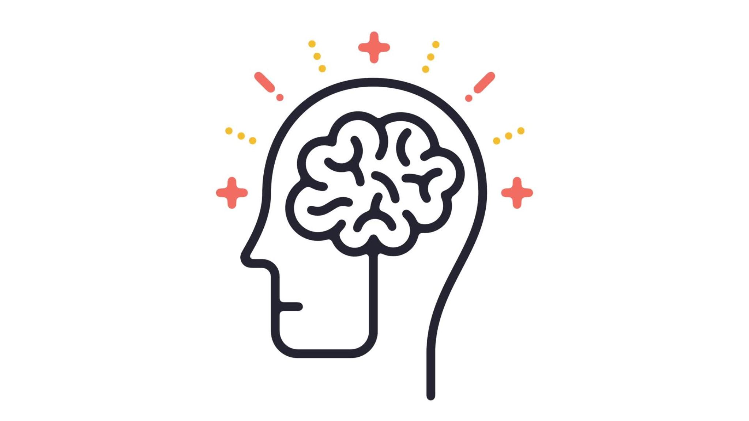
Applications in Alzheimer'S
Cognitive Training and Monitoring
Research Insights
Brain Stimulation
Neurofeedback
Clinical Trials and Treatment Development
Neurology
Neuropharmacology
Neuropathology Studies

Slide 24
Neuroscience applications
Applications
Brain-computer interface (original idea)
​Neurology
Neurobiology
Neurochemistry
Neuroimaging
Neurolinguistics
Neuroprosthetics
Neurobotics or Neurorobotics
​Paralysis
Alzheimer's
Parkinson's (About 1 million in US living with Parkinson's)
Medical brain scans
Translate brain signals to digital commands
Communication Aids (handwriting)

Slide 25
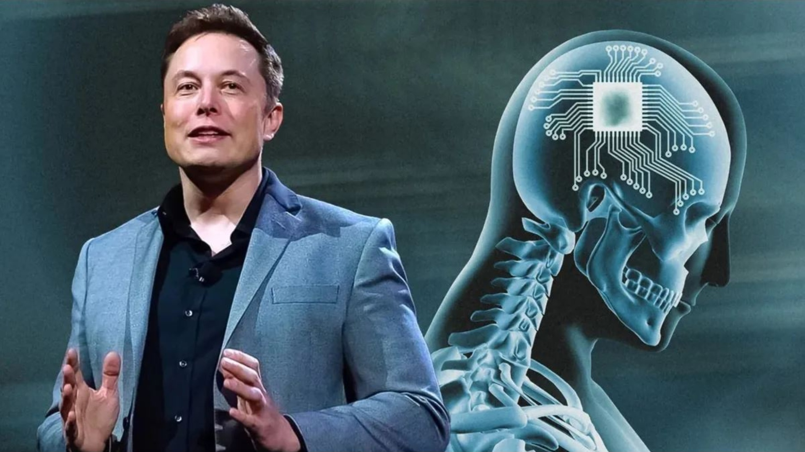
Elon Musk and Neuralink: The Brain and Computer's Shared Language
Source: https://punchng.com/how-elon-musks-neuralink-hopes-to-make-human-brain-talk-with-computers/

Slide 26

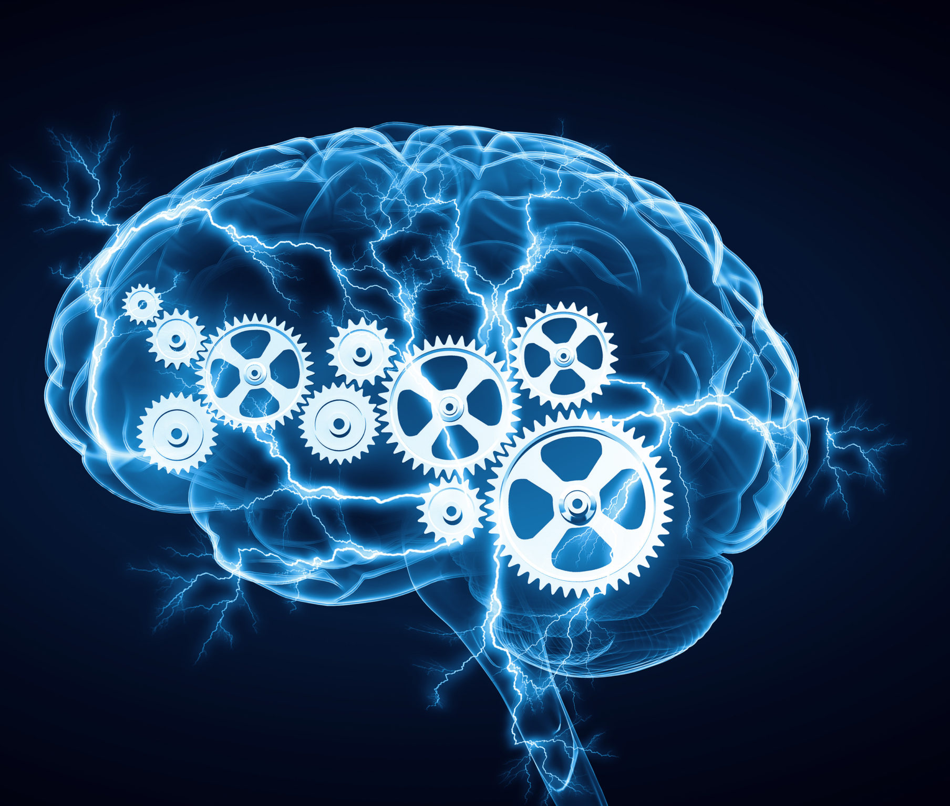
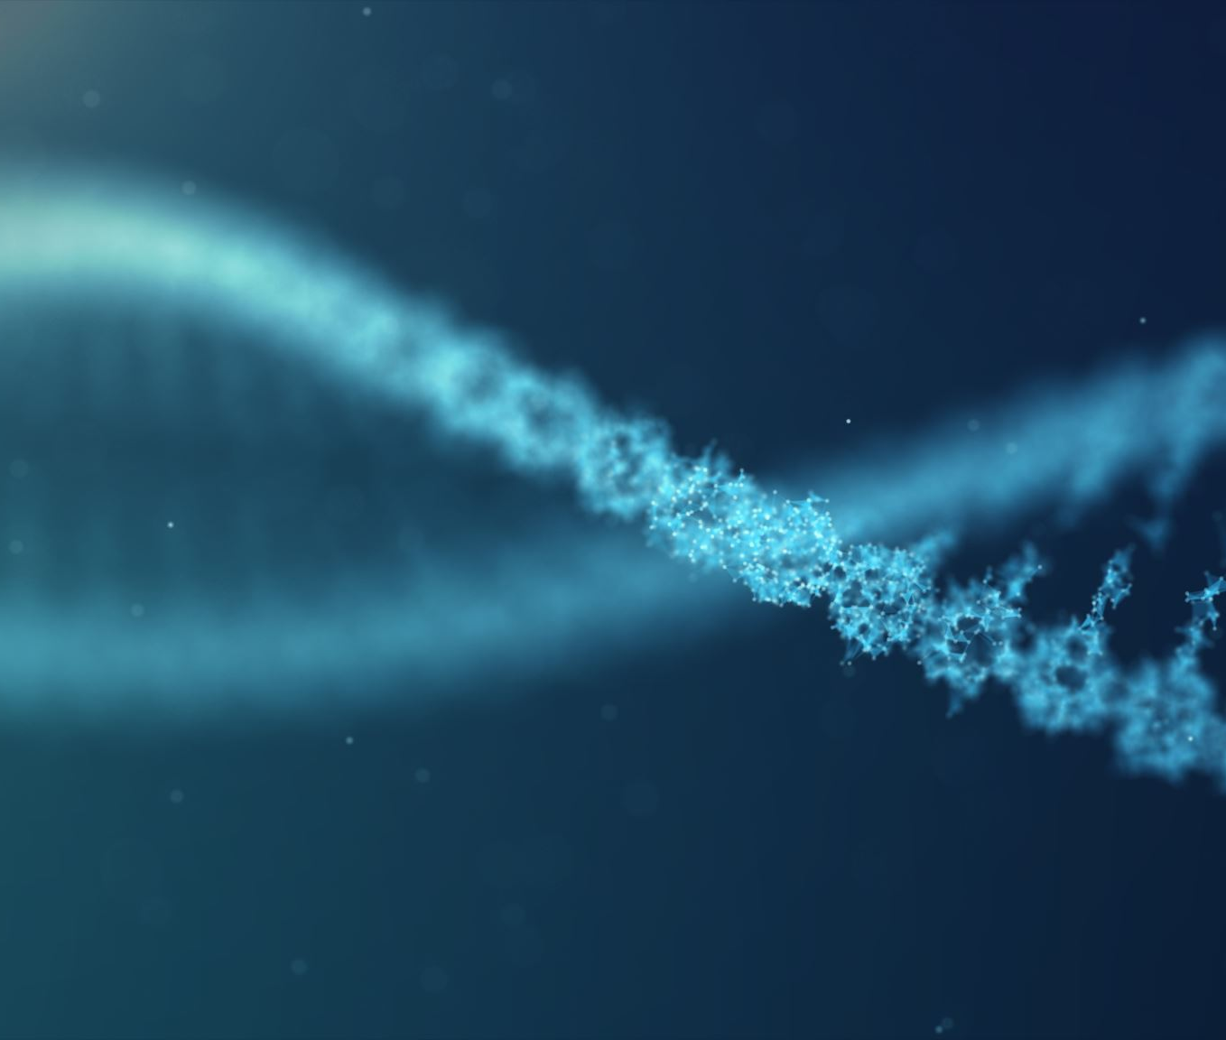
Major Field Of Study Applications
Data science
psychology
Biochemistry

Slide 27
References
Boysen, J. (2017, August 16). MRI and Alzheimers. Kaggle. https://www.kaggle.com/datasets/jboysen/mri-and-alzheimers
Salvo, C. D. (2023, January 19). The emerging technology of brain-computer interfaces in clinical research. PharmaFeatures. https://pharmafeatures.com/the-emerging-technology-of-brain-computer-interfaces-in-clinical-research/
Marr, B. (2023, October 4). Ai’s Next Frontier: Are Brain-computer interfaces the future of Communication? Forbes. https://www.forbes.com/sites/bernardmarr/2023/08/11/ais-next-frontier-are-brain-computer-interfaces-the-future-of-communication/?sh=56995a051d96
Burns, H., & Burns, S. (2023, April 7). The Neuroscience of Learning. New Trader U. https://www.newtraderu.com/2023/04/07/the-neuroscience-of-learning/
Globe Photos. (n.d.). Rita Hayworth affair in Trinidad by Globe Photos. Fine Art America. https://fineartamerica.com/featured/rita-hayworth-affair-in-trinidad-globe-photos.html
Oxford languages and google - english. Oxford Languages. (n.d.). https://languages.oup.com/google-dictionary-en/
Spaan, Pauline EJ., Raajmakers,Jeoren G.W., Jonker, Cess. 2003. Alzheimer’s Disease Versus Normal Ageing: A Review of the Efficiency of
Clinical and Experimental Memory Measures.https://pubmed.ncbi.nlm.nih.gov/12754679/
Krietzburg, Ian. (2023, November 27). Elon Musk Makes New Promises For One of His More Unusual Ventures. The
Street. https://www.thestreet.com/technology/elon-musk-makes-an-enormous-new-promise-for-neuralink

Slide 28

Thank you
Questions?​

